Slide 1
The GESTALT PRINCIPLES

Slide 2
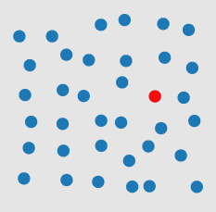
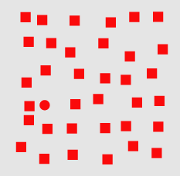
Visual Processing
pre-attentive
Perception is fragmented – eyes are continuously scanning.
Visual thinking seeks patterns
Pre-attentive processes: fast, instinctive, efficient, multitasking gather information and build patterns:
features → patterns → objects
Attentive processes: slow, deliberate, focused discover features in the patterns:
objects → patterns → features
attentive
Notes:
Pre-attentive processes

Slide 3
PRE-ATTENTIVE ATTRIBUTES
How many 6’s
In the next slide?

Slide 4
2869408609876
9348586748676
2967303986739
3967496749674

Slide 5
2869408609876
9348586748676
2967303986739
3967496749674

Slide 6
2869408609876
9348586748676
2967303986739
3967496749674

Slide 7
2869408609876
9348586748676
2967303986739
3967496749674

Slide 8
2869408609876
9348586748676
2967303986739
3967496749674

Slide 9
22333334444445
66666666666777
77777888888899
9999999000

Slide 10
66666666666
999999999
77777777
8888888
444444
33333
000
22
5

Slide 11
66666666666
999999999
77777777
8888888
444444
33333
000
22
5

Slide 12
2869408609876
9348586748676
2967303986739
3967496749674

Slide 13
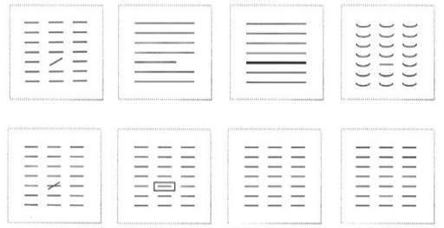
Pre-Attentive ATTRIBUTES
[I. Meirelles, Design for Information]
line orientation
line length
line weight
curvature
added marks
enclosure
color/hue
intensity/value

Slide 14
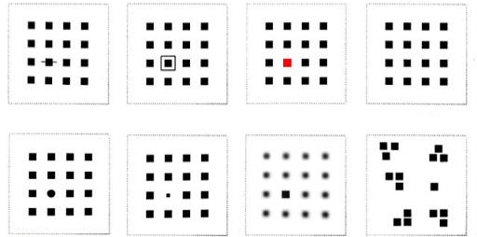
Pre-Attentive ATTRIBUTES
[I. Meirelles, Design for Information]
added marks
enclosure
color/hue
intensity/value
shape
size
sharpness
numerosity

Slide 15
Pre-attentive Attributes
Pre-attentive attributes are the domain of iconic memory (brief): they
help to define a hierarchy of focus
push non-message impacting components into the background
Use pre-attentive attributes to help emphasize the story (but don’t overdo them):
easier to do in Excel and R, harder in Power BI
Challenge: highlighting one aspect of a chart can make other aspects harder to see.

Slide 16
GESTALT PRINCIPLES
[www.interaction-design.org/literature/topics/gestalt-principles]
What are the Gestalt Principles?
Principles/laws of human perception.
They describe how humans group similar elements, recognize patterns and simplify complex images when they perceive objects.
Designers use them to organize content on charts, dashboards, websites, and other interfaces so that they be aesthetically pleasing and easy to understand.

Slide 17
GESTALT PRINCIPLES
[www.interaction-design.org/literature/topics/gestalt-principles]
Background:
“Gestalt” is German for “unified whole”.
The first principles were devised in the 1920s by German psychologists Wertheimer, Koffka (“the whole is greater than the sum of the parts”) and Kohler
Their aim: understand how humans gain meaning from the chaotic stimuli around them.
They identified a set of laws which address the natural compulsion to find order in disorder.
According to this, the mind “informs” what the eye sees by perceiving a series of individual elements as a whole.

Slide 18
GESTALT PRINCIPLES
Principles:
simplicity
continuation
proximity
similarity (invariance)
focal point
isomorphic correspondence
figure / ground duality
common fate
closure*
uniform connectedness*

Slide 19
Simplicity
The brain has a preference for simplicity – it tends to process simple patterns faster than patterns that are more complex.
Lesson: arrange data simply and logically wherever possible.

Slide 20
ContinuATION
Our eyes group things that are aligned (e.g. sorted from high to low) with each other.
In the chart on the right the eyes follow a continuous path; it makes the whole chart more readable because of the continuous downward direction
Lesson: arrange objects in a line to facilitate grouping and comparison.

Slide 21
Proximity
Objects/shapes that are in proximity (close) to one another appear to form groups.
The effect generated by the collected group is more “powerful” than that generated by separate elements.
Elements which are grouped together create the illusion of shapes/planes in space, even if the elements are not touching.
Lesson: understand the chart’s priorities and create groupings through proximity that support those priorities.

Slide 22
Proximity
vs.

Slide 23
Proximity
vs.

Slide 24
Proximity
vs.

Slide 25
Proximity
vs.

Slide 26
Similarity (INVARIANCE)
Similarity: stimuli that physically resemble each other are viewed as part of the same object; stimuli that don’t are viewed as part of a different object.
Similarity and proximity often come together to form a Visual Hierarchy. Either principle can dominate the other, depending on their application and combination.
Lesson: use similar characteristics to establish relationships and to encourage groupings of objects.

Slide 27
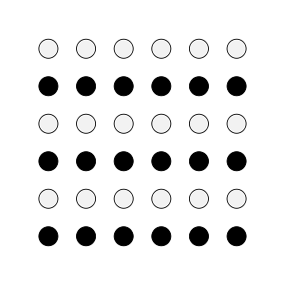
Similarity (INVARIANCE)

Slide 28
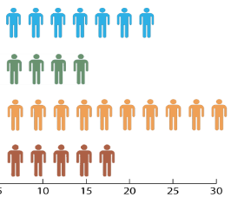
Similarity (INVARIANCE)
In the examples above, similarity dominates over proximity: we see rows before we see columns.

Slide 29
Similarity (INVARIANCE)

Slide 30
Similarity (INVARIANCE)
Making things similar can reduce cognitive load (cf. last graph colour).

Slide 31
Focal Point
In opposition to similarity, the focal point principle states that distinctive-looking objects can create a focal point.
To highlight one salesperson’s performance, make their bar graph color different.
Lesson: use different characteristics to highlight and create focal points.

Slide 32
Focal Point
In opposition to similarity, the focal point principle states that distinctive-looking objects can create a focal point.
To highlight one salesperson’s performance, make their bar graph color different.
Lesson: use different characteristics to highlight and create focal points.

Slide 33
Isomorphic Correspondence
People interpret and respond to images based on past/shared experiences (in particular, for the selection of chart colours).
Red is often associated with bad and green with good (colour-blindness?). We can colour-code charts accordingly.
Lesson: stick to well-established conventions and best practices (even if boring!)

Slide 34
Figure / Ground DUALITY
Chart elements are either perceived as figures (focus) or as (back)ground.
Foreground objects are promoted by the brain, background objects are demoted.
Strong contrast makes it easier to distinguish between the two types of objects.
Lesson: ensure there is enough contrast between the chart foreground (figures) and their background.

Slide 35
Figure / Ground DUALITY
Because of the low contrast between the figure and background in the chart on the left, there is an additional cognitive load.
Increasing the contrast on the right improves readability.
vs.

Slide 36
Figure / Ground DUALITY
Because of the low contrast between the figure and background in the chart on the left, there is an additional cognitive load.
Increasing the contrast on the right improves readability.
vs.

Slide 37
DECLUTTERING

Slide 38
Decluttering
CLUTTER IS THE ENEMY!
every element on a page adds cognitive load
identify anything that isn’t adding value and remove
think of cognitive load as mental effort required to process information (lower is better)
Tufte refers to the data to ink ratio – “the larger the share of a graphic’s ink devoted to data, the better”
in Resonate, Duarte refers to this as “maximizing the signal-to-noise ratio” where the signal is the information or the story we want to communicate.

Slide 39
Decluttering
Use the Gestalt Principles to organize/highlight data in the chart.
Align all the elements (graphs, text, lines, titles, etc).
DON’T rely on eye, use position boxes and values
Charts:
remove border, gridlines, data markers
clean up axis labels
label data directly
Things
More things

Slide 40
Decluttering
Use consistent font, font size, colour and alignment.
Don’t rotate text to anything other than 0 or 90 degrees.
Use white space:
margins should remain free of text and visuals
don’t stretch visuals to edge of page or too close to other visuals
think of white space as a border

Slide 41
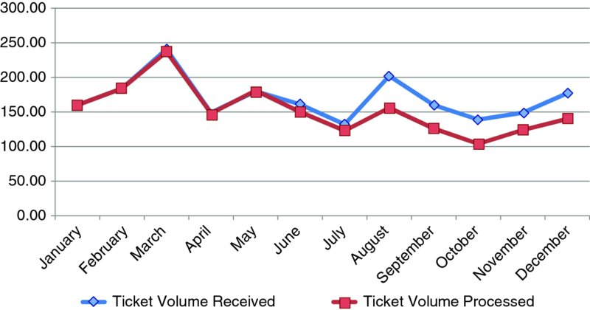
Declutering – Step-by-Step Example
Source: Storytelling with Data

Slide 42
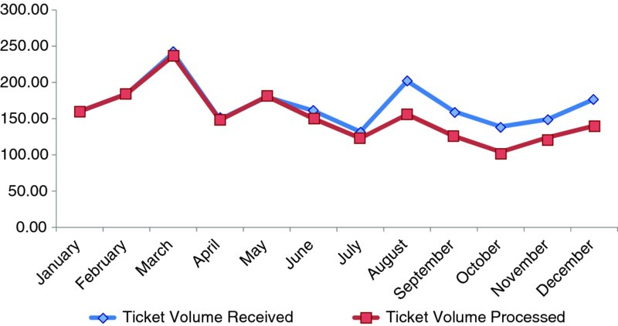
1. Remove Chart Border & Gridlines
Source: Storytelling with Data

Slide 43
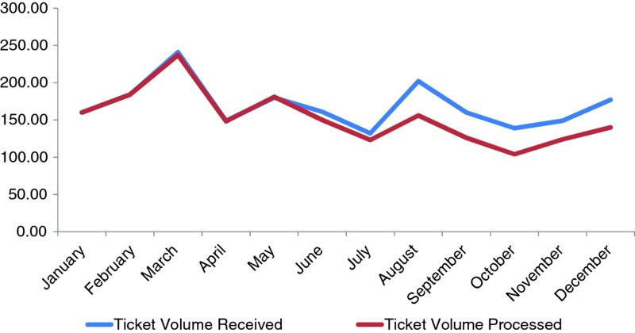
2. Remove Data Markers
Source: Storytelling with Data

Slide 44
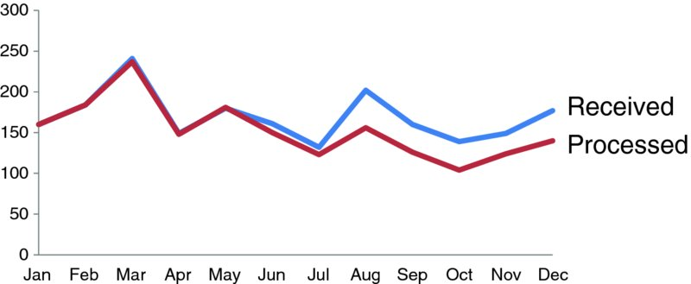
3. Clean Up Axis Labels
Source: Storytelling with Data

Slide 45
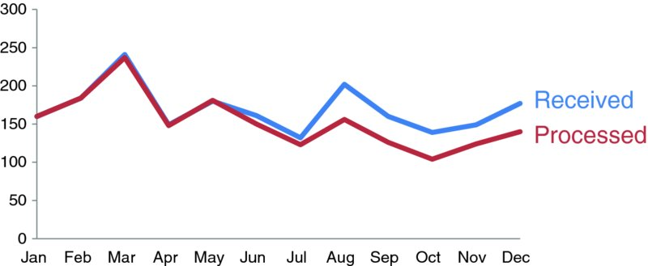
4. Colour Code the Lines
Source: Storytelling with Data

Slide 46
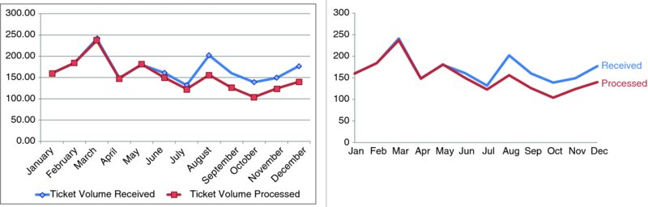
5. Before & After
Source: Storytelling with Data

Slide 47
EXERCISE
Select a few charts (either among the examples we have seen so far, or something you have seen at work).
Are they too cluttered?
Does the answer depend on the audience?
Provide some decluttering suggestions.

Slide 48
SIZE, COLOUR, AND POSITION

Slide 49
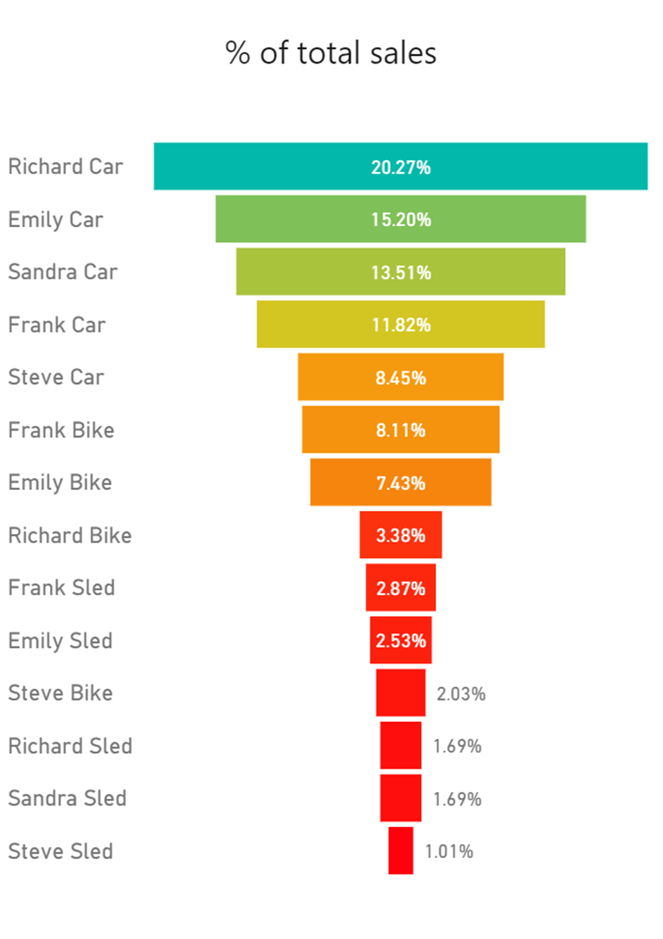
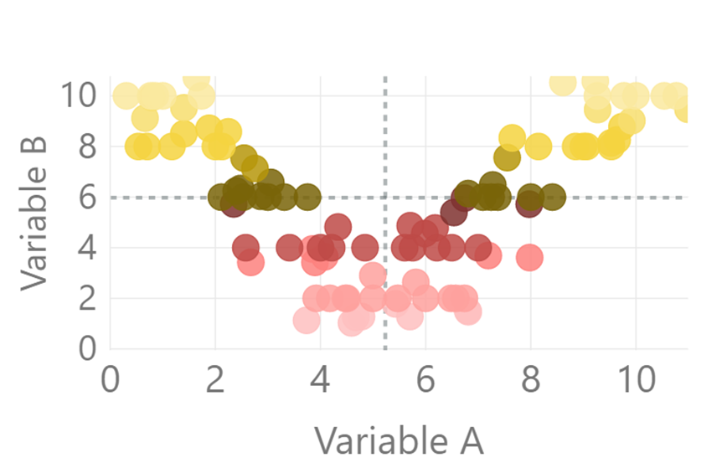
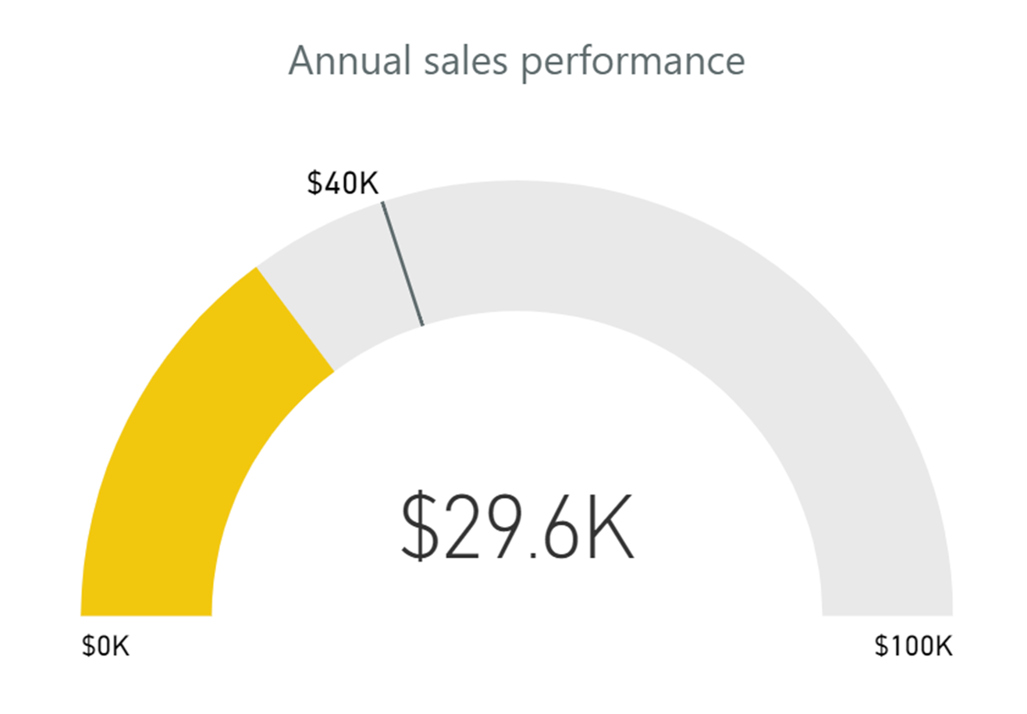
Size
Size: assuming that the chart has been decluttered
things of equal importance size similarly
other things scale to importance

Slide 50
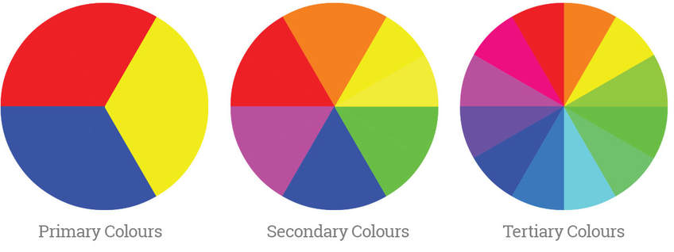
COLOUR THEORY
[akshaymishra.weebly.com/colour-theory.html]
Colour theory (complicated topic – here is a start):
http://www.deanenettles.com/webexamples/colorexamples/
https://www.sessions.edu/color-calculator/
Colour wheels:

Slide 51




COLOUR SCHEMES
[http://www.deanenettles.com/webexamples/colorexamples]
Achromatic (colourless, using only blacks, whites and grays)
Monochromatic (1-colour schemes)
Complementary (colours directly across from each other on the colour wheel)
Split complementary (2 of the 3 colors are adjacent; 1 of the colours is opposite)

Slide 52




COLOUR SCHEMES
[http://www.deanenettles.com/webexamples/colorexamples]
Split-Left and Split-Right Complementary ("split" colours are either to the left or right of the complementary colour)
Analogous (any 3 adjacent primary, secondary, or tertiary colours on the colour wheel)
Colour Diad (2 colours that are 2 colours apart on the color wheel)
Colour Triad (3 colours, equally distant from each other on the colour wheel)
Colour Tetrad (4 or more colors on the colour wheel)

Slide 53
Achromatic
Monochromatic
Complementary
Split Complementary
Left-Split Complementary
Analogous
Diad
Triad
Tetrad

Slide 54
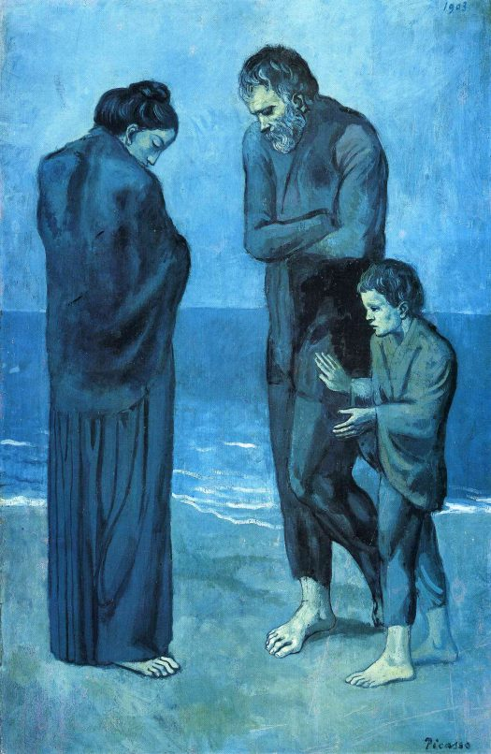

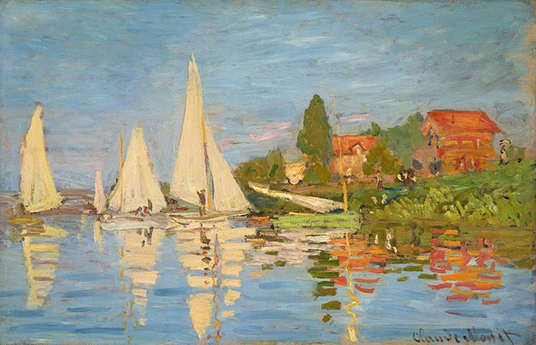




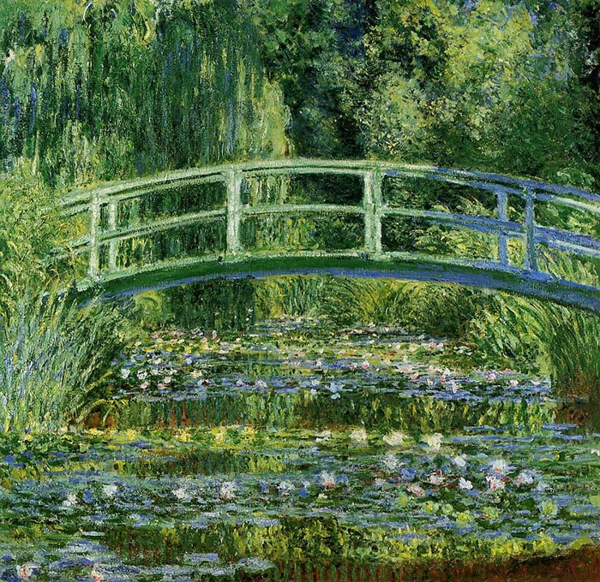

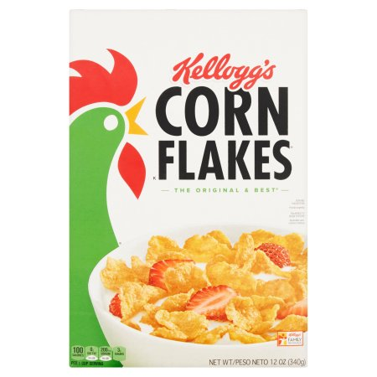
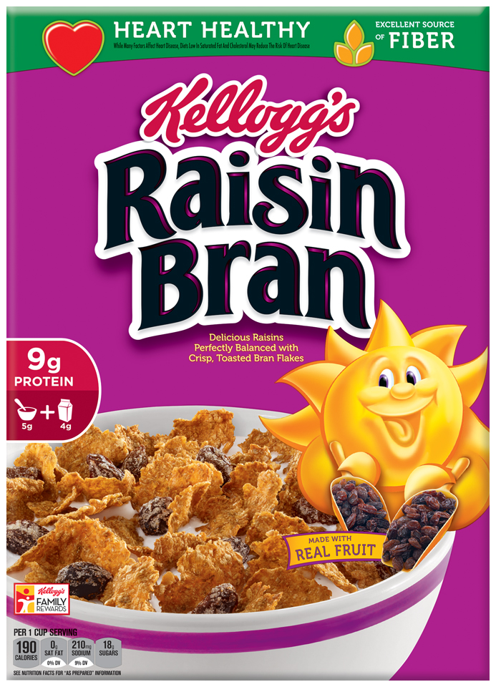

Can you identify the colour schemes underlying each of these images?

Slide 55
Split Complementary (Green, Orange & Blue)
Achromatic
Monochromatic (Blues)
Tetrad
Diad (Blue & Green)
Triad (Primary Colors)
Diad (Green & Orange)
Analogous (Green & Yellow)
Complementary
Can you identify the colour schemes underlying each of these images?
Diad (Red &Violet)

Slide 56
COLOUR PALETTES
Zeileis, Hornik & Murrell 24 Distinct Colours

Slide 57
COLOUR PALETTES
Kelly’s 22 Colours of Maximum Contrast

Slide 58
COLOUR PALETTES
Paul Tol 14 Colour Rainbow Scheme

Slide 59
Decluttering

Slide 60
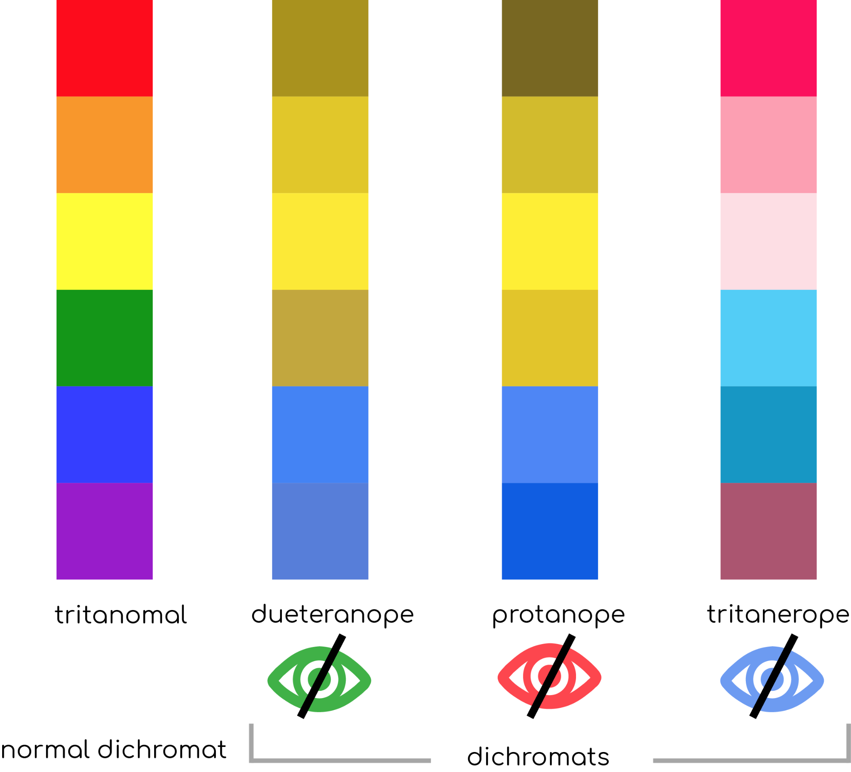
ColourBLINDNESS
[https://www.uxbooth.com/articles/accessibility-visual-design]
A sizeable proportion of the population (~8%) is colourblind, to some degree.
Charts that rely on colours might fail to convey the full extent of the data story to a significant proportion of the audience.
Consider using contrast-friendly palettes, and not using colour alone to convey the data story.

Slide 61
COLOUR TIPS
When it comes to colour, less is more: use it sparingly (graphic designers are taught to “get it right, in black and white”).
Based on the Gestalt Principles, monochrome schemes can be particularly effective.
When appropriate, pick scheme based on corporate identity (this maximizes buy in).
Create a template (and stick to it).
Upload images to see what charts look like in various flavours of colour-blindness:
https://www.color-blindness.com/coblis-color-blindness-simulator (there are other tools)

Slide 62
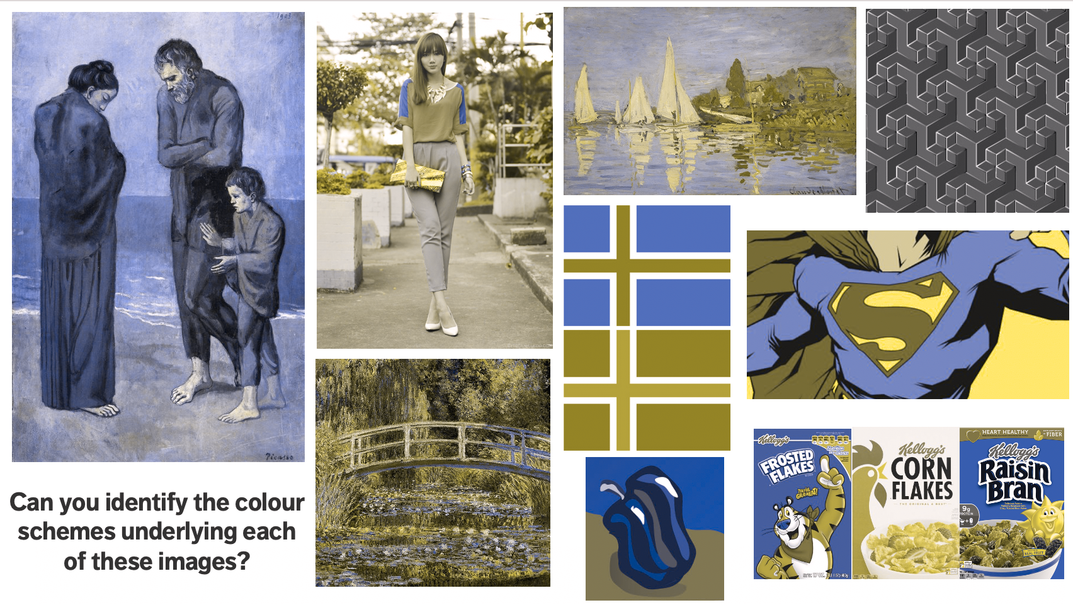
Dichromatic
protanopia (red-blind)

Slide 63
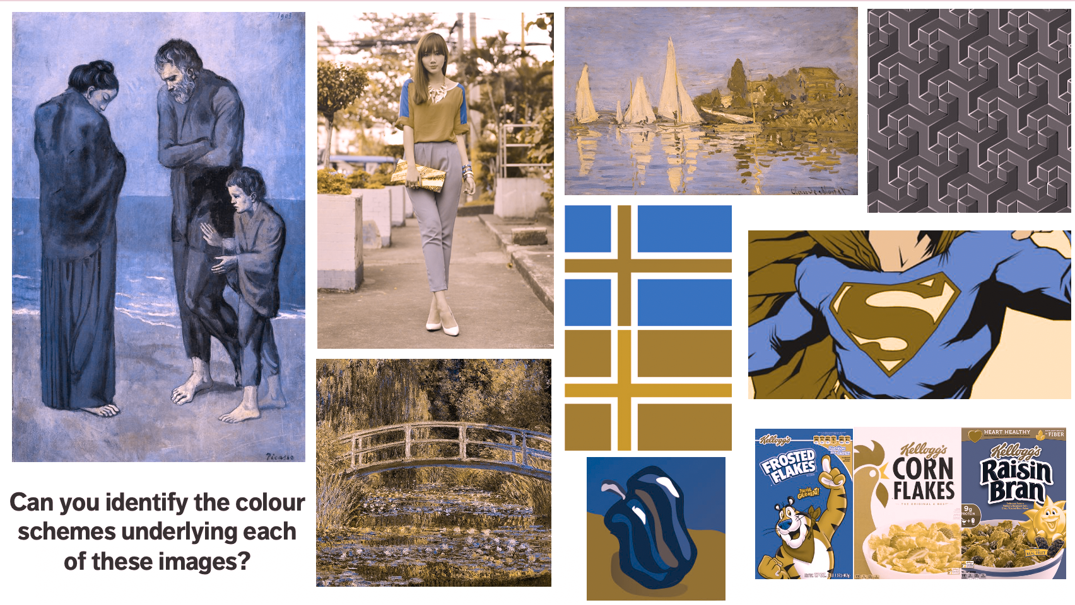
Dichromatic
deuteranopia (green-blind)

Slide 64
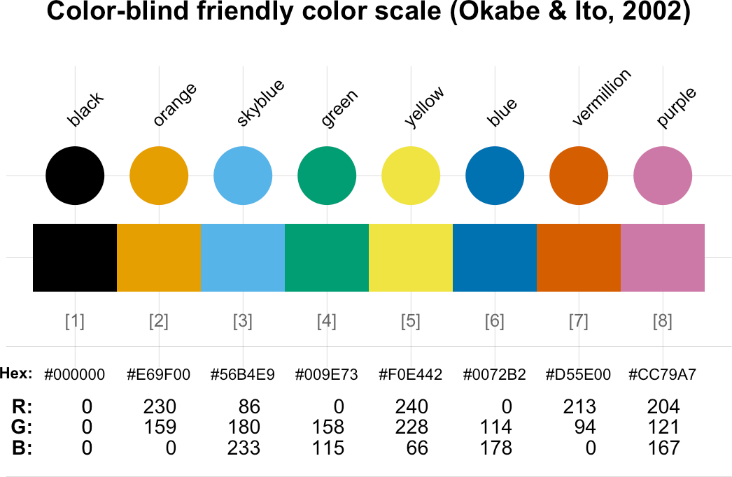

Slide 65
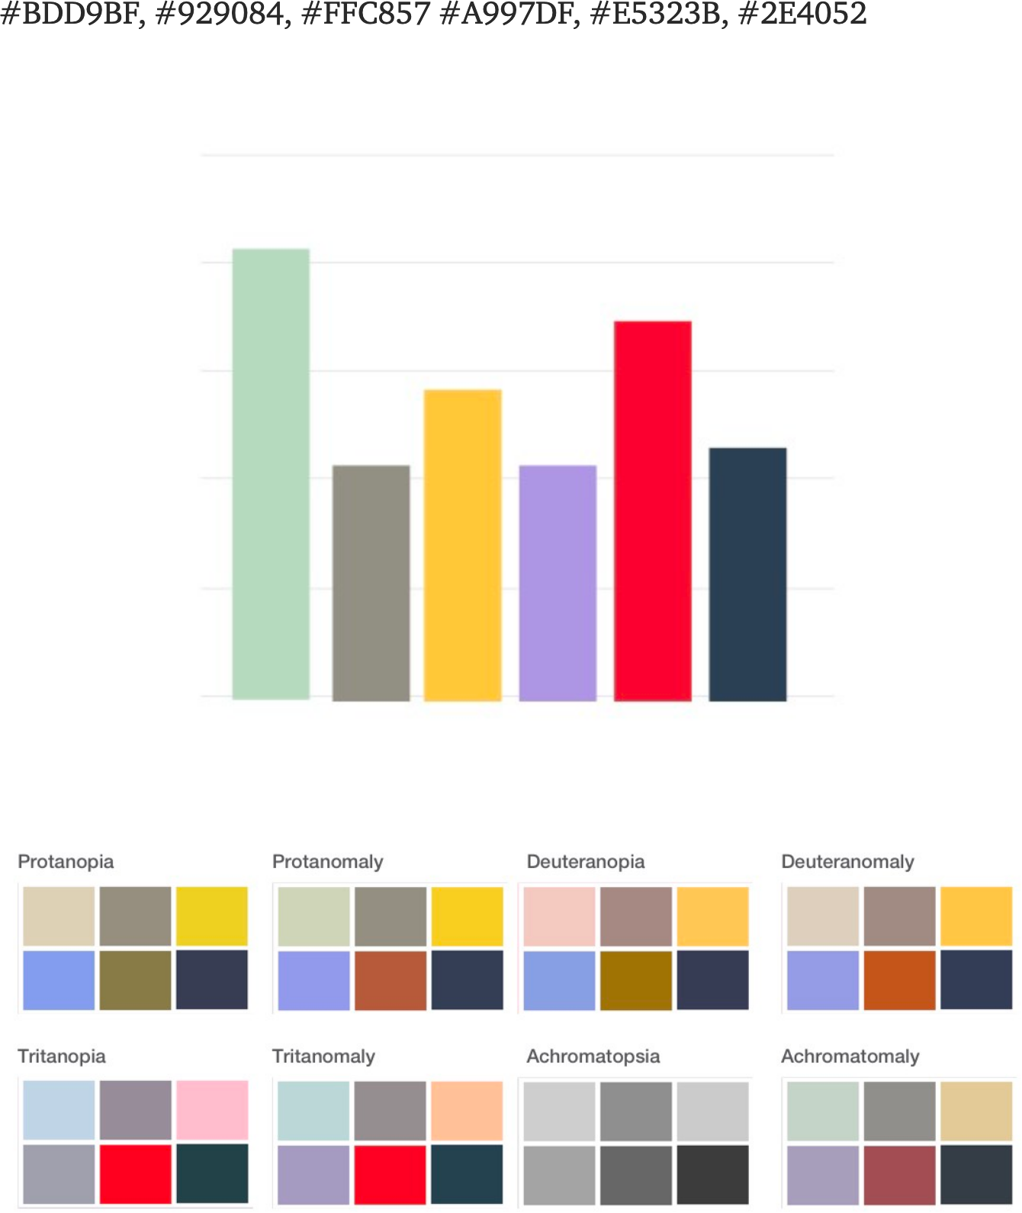
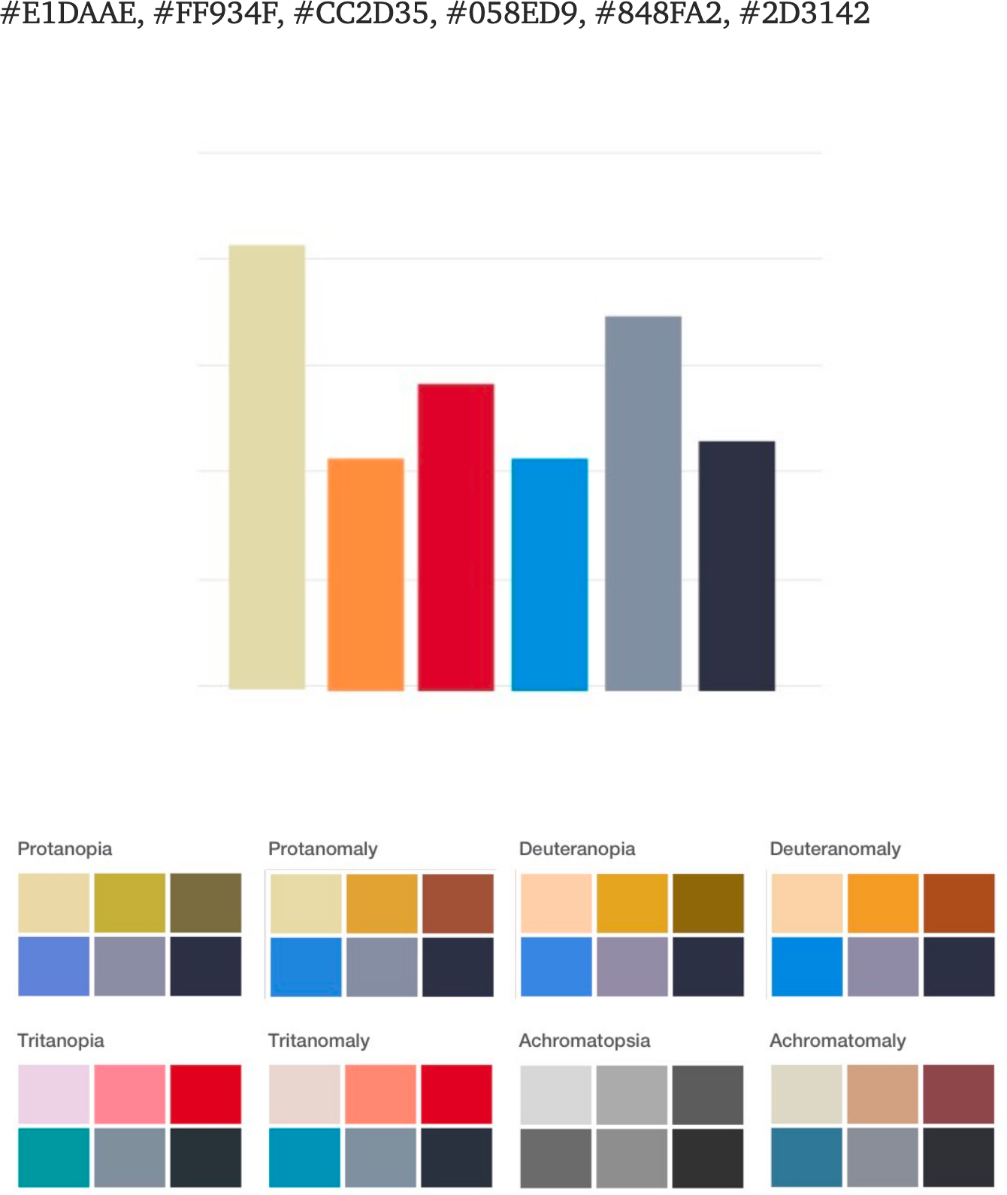
Colour-BLINDNESS
[A. Ofisher, https://medium.com/cafe-pixo/inclusive-color-palettes-for-the-web-bbfe8cf2410e]

Slide 66
SIZE, COLOUR, AND POSITION
How should the elements be placed in a chart or a dashboard?
In the West, most people start at the top left and zig- zag all the way to the bottom right.
Simple rule: don’t make people work too hard
main message: top left/top right
info in order of preference
people concentrate less as they scan so get less complex as you move to bottom corner
1
2
3
4

Slide 67
ACCESSIBILITY

Slide 68
A WORD ABOUT Accessibility
[http://dataphys.org/list/]
A table can be translated to Braille, but that’s not always possible for charts.
Describing the features and emerging structures in a visualization is a possible solution… if they can be spotted.
Analysts must produce clear and meaningful visualizations, but they must also describe them and their features in a fashion that allows all to "see" the insights.
This requires them to have “seen” all the insights, which is not always necessarily the case (if at all possible).

Slide 69
A WORD ABOUT Accessibility
Data Perception:
texture-based representations
text-to-speech
sound/music
odor-based or taste-based representations (?!?)
Sonifications:
TRAPPIST Sounds : TRAPPIST-1 Planetary System Translated Directly Into Music
Listening to data from the Large Hadron Collider, L. Asquith

Slide 70

A Word ABOUT ACCESSIBILITY

Slide 71
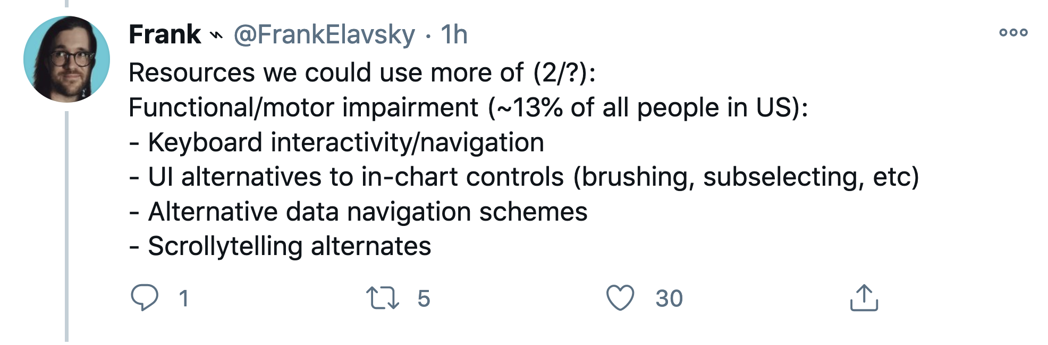
A Word ABOUT ACCESSIBILITY

Slide 72
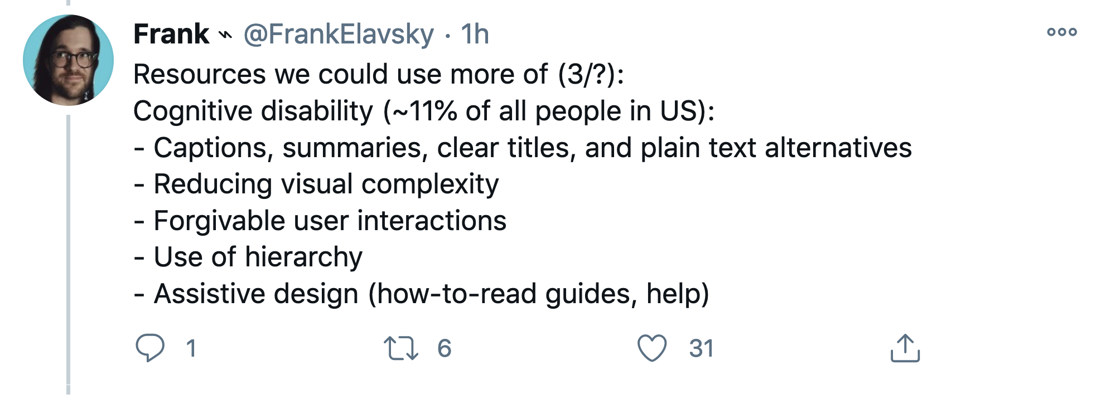
A Word ABOUT ACCESSIBILITY

Slide 73
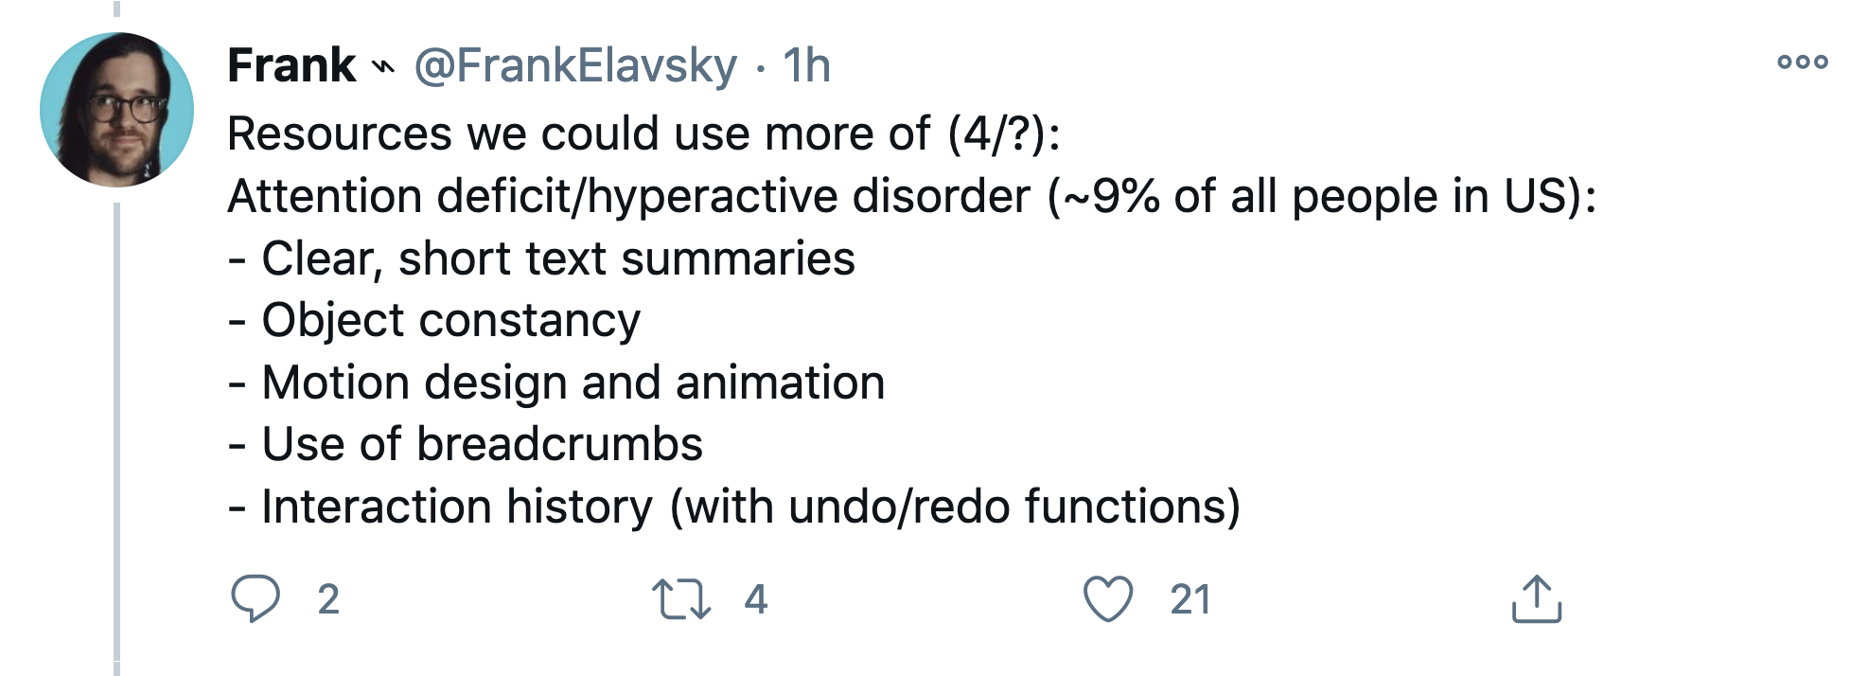
A Word ABOUT ACCESSIBILITY

Slide 74
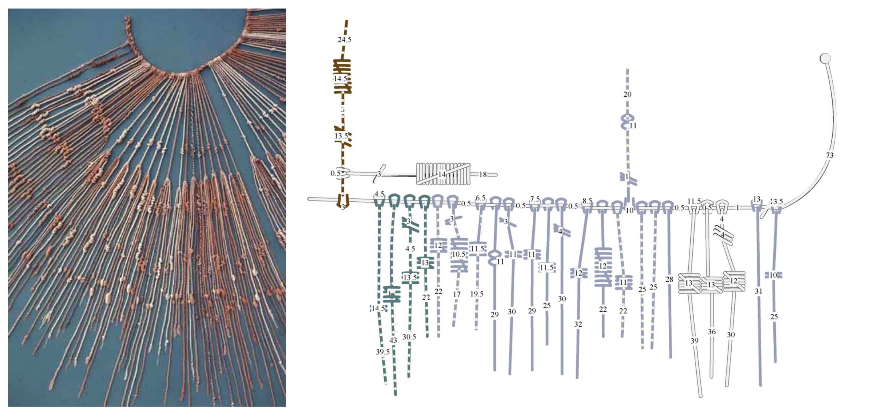
PHYSICALIZATIONS
[http://dataphys.org]
Inca Quipus
used as a data storage device
it is believed that color, relative position of knots, knot types, and rope length were used to encode the variables.

Slide 75
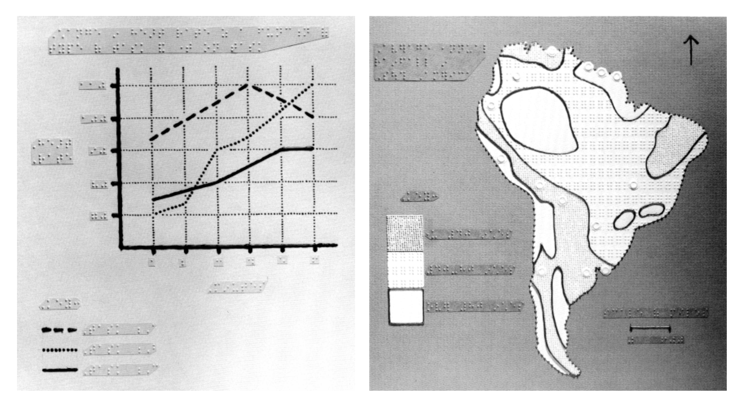
PHYSICALIZATIONS
[http://dataphys.org]
Tactile Infographics
thermoform: heated sheet of plastic sealed on a physical model
swell paper: thermoform-lite
tactile map variables: vibration, flutter, pressure, temperature, size, shape, texture, grain, orientation, and elevation.
audio tactile maps: use software with audio files to convey information as the user’s finger rolls over features or symbols

Slide 76
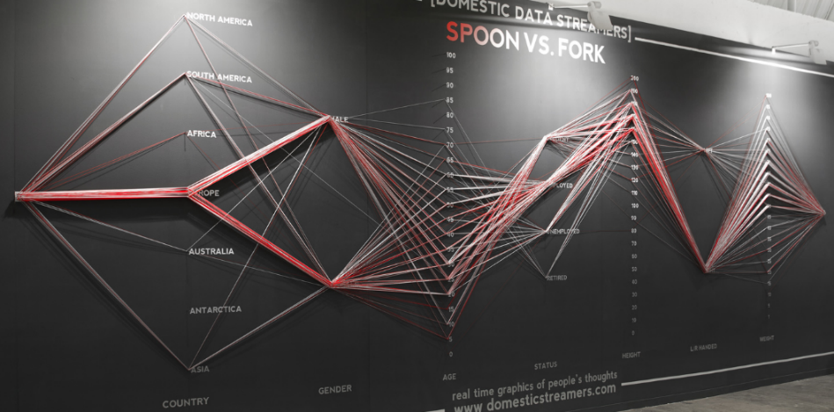
[domesticstreamers.com]
Spoon vs. Fork
Are there any issues with data collection? Where do you think this event took place? Is the spoon/fork question a red herring?

